Slide 1
Introduction to Differential Equations - Lecture 7
Fei Qi
Email: fei.qi@du.edu
Office Hour: TBA
Website: https://feiqimath.github.io

Slide 2
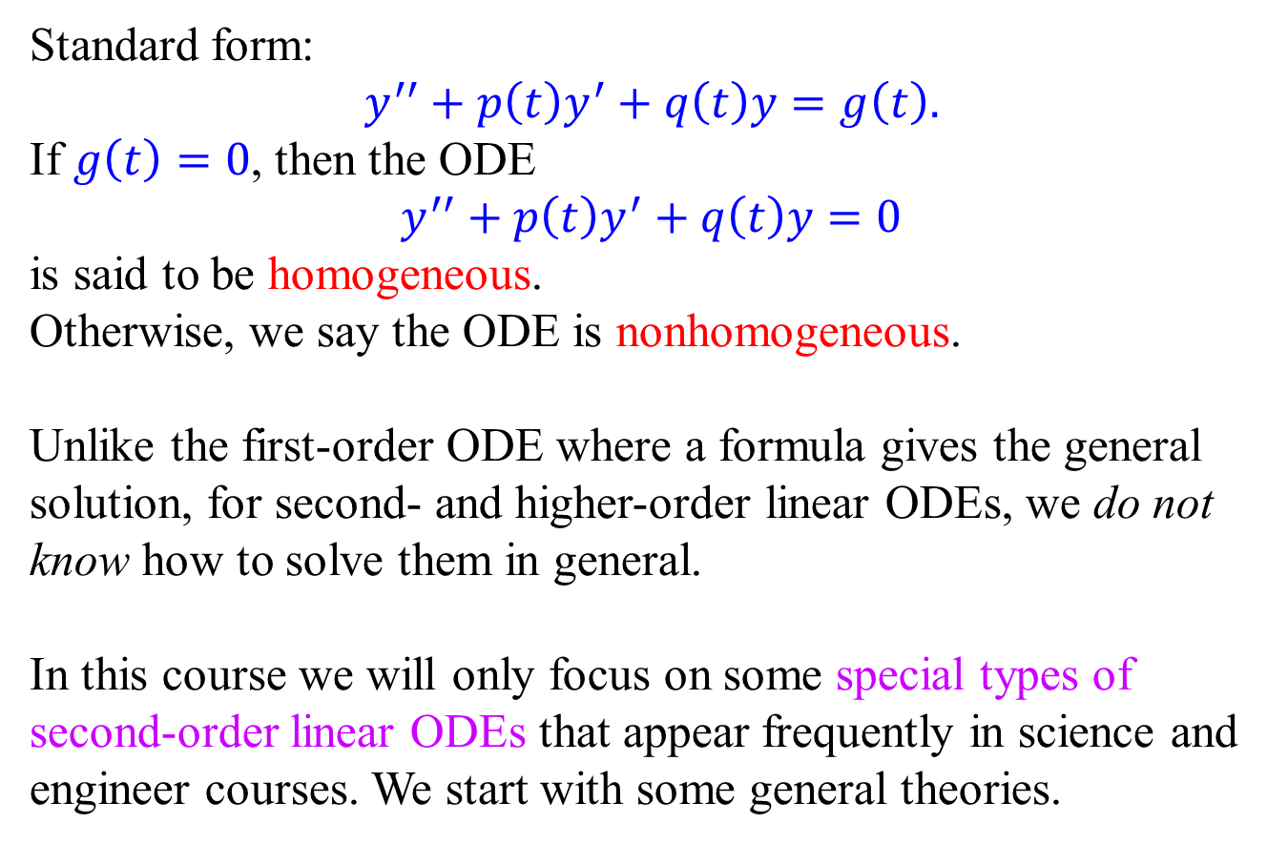
Second-order Linear ODE
Standard form:
$$y^{′′}+p\left(t\right)y^{′}+q\left(t\right)y=g\left(t\right).$$
If $g\left(t\right)=0$, then the ODE
$$y^{′′}+p\left(t\right)y^{′}+q\left(t\right)y=0$$
is said to be homogeneous.
Otherwise, we say the ODE is nonhomogeneous.
Unlike the first-order ODE where a formula gives the general solution, for second- and higher-order linear ODEs, we do not know how to solve them in general.
In this course we will only focus on some special types of second-order linear ODEs that appear frequently in science and engineer courses. We start with some general theories.

Slide 3
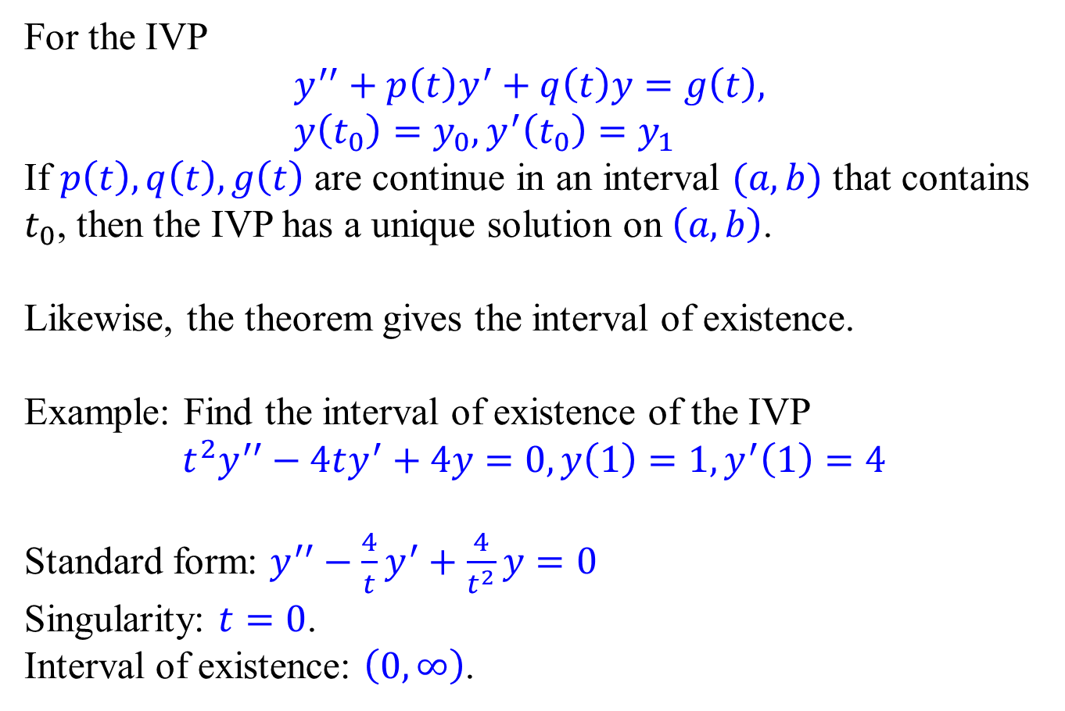


Existence and Uniqueness Theorem
For the IVP
$$y^{′′}+p\left(t\right)y^{′}+q\left(t\right)y=g\left(t\right), \\ y\left(t_{0}\right)=y_{0},y^{′}\left(t_{0}\right)=y_{1}$$
If $p\left(t\right), q\left(t\right), g\left(t\right)$ are continue in an interval $(a, b)$ that contains $t_{0}$, then the IVP has a unique solution on $\left(a,b\right)$.
Likewise, the theorem gives the interval of existence.
Example: Find the interval of existence of the IVP
$$t^{2}y^{′′}−4ty^{′}+4y=0,y\left(1\right)=1,y^{′}\left(1\right)=4$$
Standard form: $y^{′′}−\frac{4}{t}y^{′}+\frac{4}{t^{2}}y=0$
Singularity: $t=0$.
Interval of existence: $\left(0,∞\right)$.
Standard form!
$$0$$
$$1$$

Slide 4
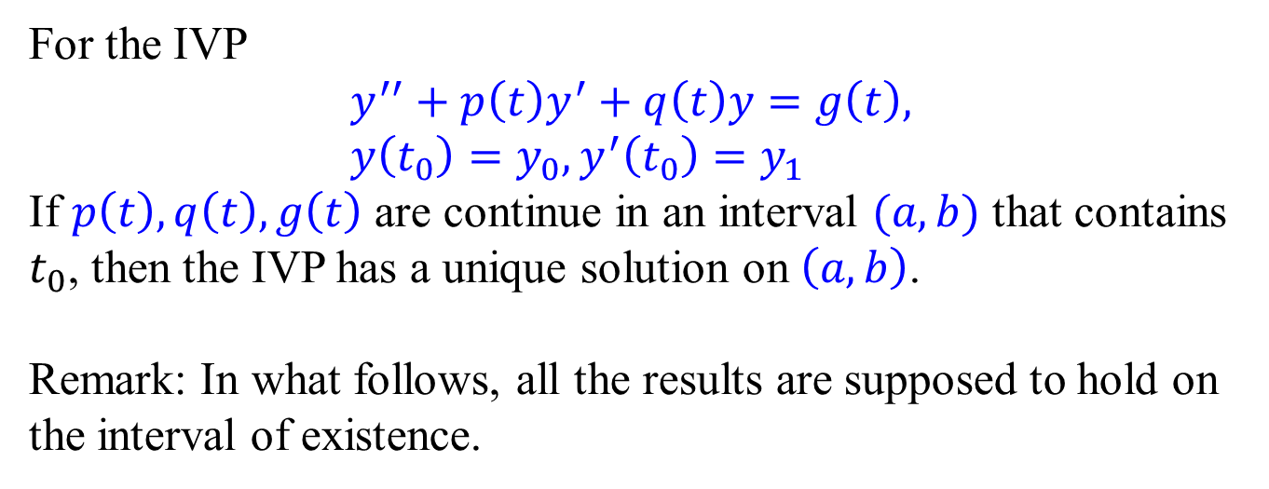
Existence and Uniqueness Theorem
For the IVP
$$y^{′′}+p\left(t\right)y^{′}+q\left(t\right)y=g\left(t\right), \\ y\left(t_{0}\right)=y_{0},y^{′}\left(t_{0}\right)=y_{1}$$
If $p\left(t\right), q\left(t\right), g\left(t\right)$ are continue in an interval $(a, b)$ that contains $t_{0}$, then the IVP has a unique solution on $\left(a,b\right)$.
Remark: In what follows, all the results are supposed to hold on the interval of existence.
Standard form!

Slide 5
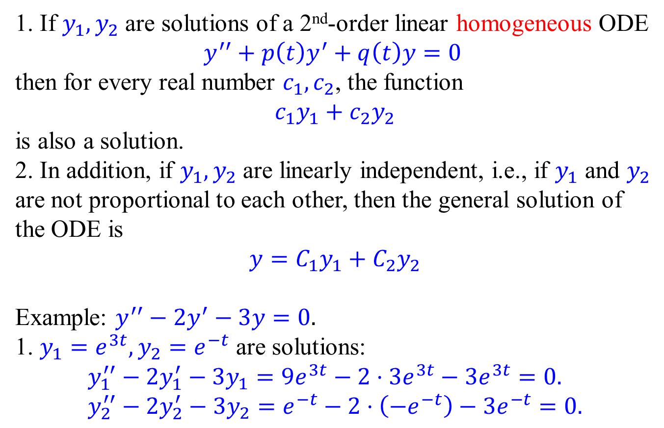
Principle of Superposition
1. If $y_{1},y_{2}$ are solutions of a 2nd-order linear homogeneous ODE
$$y^{′′}+p\left(t\right)y^{′}+q\left(t\right)y=0$$ then for every real number $c_{1},c_{2}$, the function
$$c_{1}y_{1}+c_{2}y_{2}$$
is also a solution.
2. In addition, if $y_{1},y_{2}$ are linearly independent, i.e., if $y_{1}$ and $y_{2}$ are not proportional to each other, then the general solution of the ODE is
$$y=C_{1}y_{1}+C_{2}y_{2}$$
Example: $y^{′′}−2y^{′}−3y=0.$
1. $y_{1}=e^{3t}, y_{2}=e^{−t}$ are solutions:
$$y_{1}^{′′}−2y_{1}^{′}−3y_{1}=9e^{3t}−2⋅3e^{3t}−3e^{3t}=0. \\ y_{2}^{′′}−2y_{2}^{′}−3y_{2}=e^{−t}−2⋅\left(−e^{−t}\right)−3e^{−t}=0.$$

Slide 6
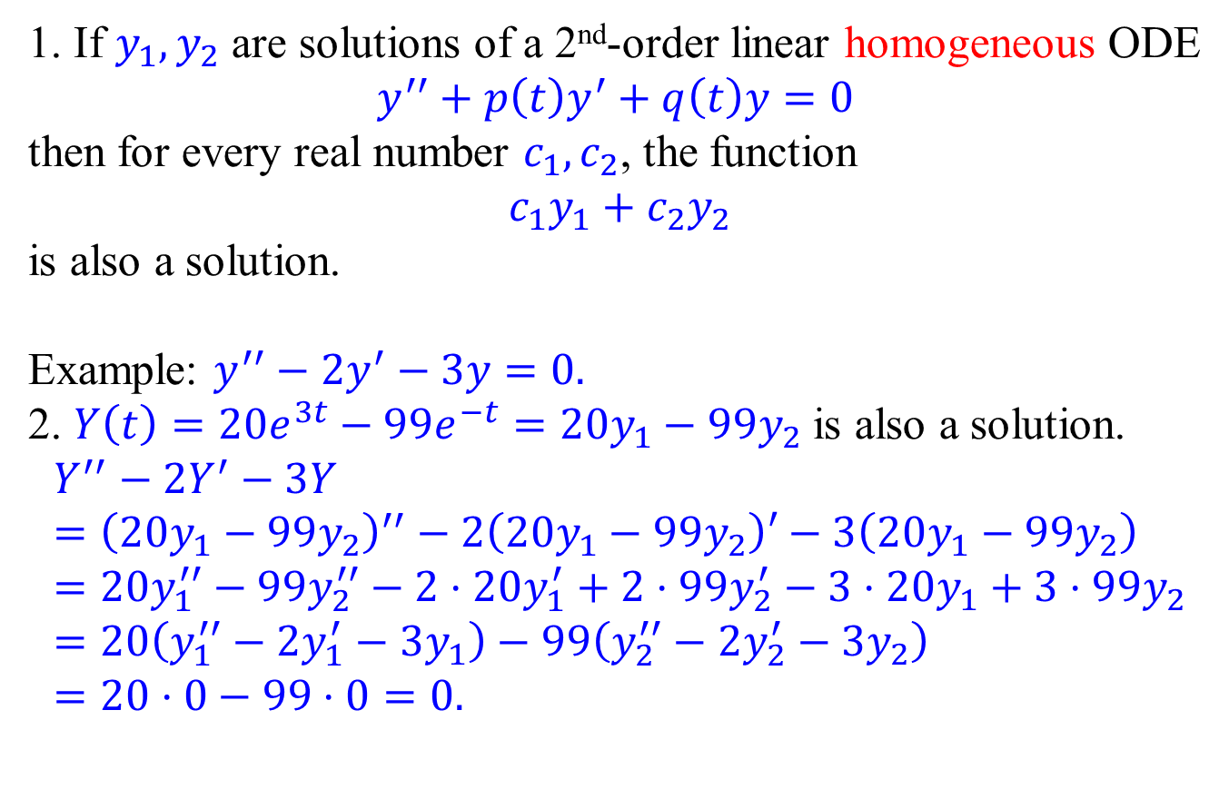
Principle of Superposition
1. If $y_{1},y_{2}$ are solutions of a 2nd-order linear homogeneous ODE
$$y^{′′}+p\left(t\right)y^{′}+q\left(t\right)y=0$$ then for every real number $c_{1},c_{2}$, the function
$$c_{1}y_{1}+c_{2}y_{2}$$
is also a solution.
Example: $y^{′′}−2y^{′}−3y=0.$
2. $Y\left(t\right)=20e^{3t}−99e^{−t}=20y_{1}−99y_{2}$ is also a solution.
$$Y^{′′}−2Y^{′}−3Y={\left(20y_{1}−99y_{2}\right)}^{′′}−2\left(20y_{1}−99y_{2}\right)′−3\left(20y_{1}−99y_{2}\right) \\ =20y_{1}^{′′}−99y_{2}^{′′}−2⋅20y_{1}^{′}+2⋅99y_{2}^{′}−3⋅20y_{1}+3⋅99y_{2} \\ =20\left(y_{1}^{′′}−2y_{1}^{′}−3y_{1}\right)−99\left(y_{2}^{′′}−2y_{2}^{′}−3y_{2}\right) \\ =20⋅0−99⋅0=0.$$

Slide 7
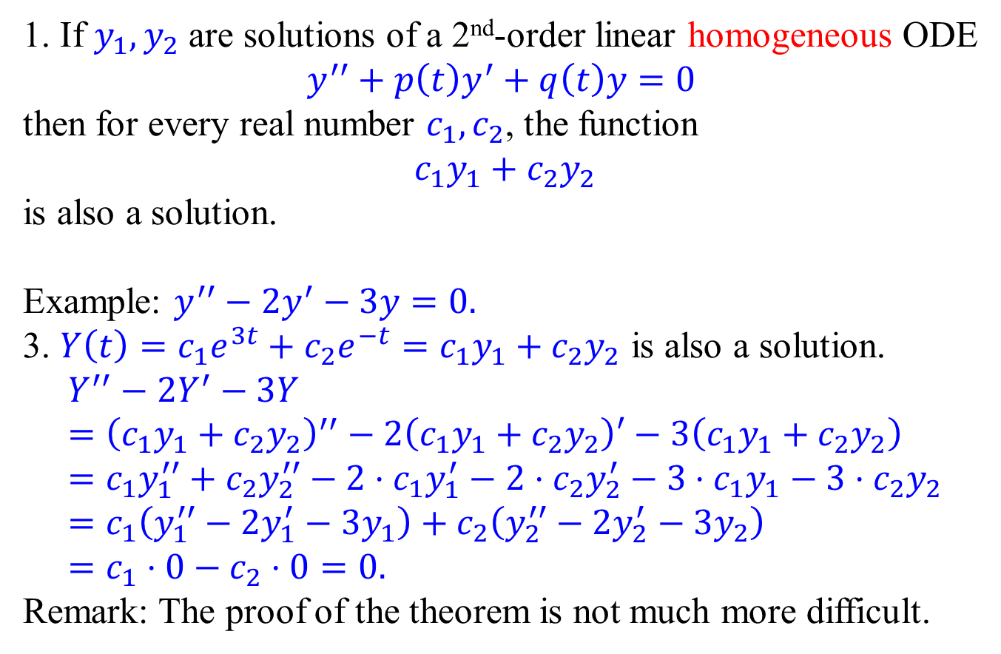
Principle of Superposition
1. If $y_{1},y_{2}$ are solutions of a 2nd-order linear homogeneous ODE
$$y^{′′}+p\left(t\right)y^{′}+q\left(t\right)y=0$$ then for every real number $c_{1},c_{2}$, the function
$$c_{1}y_{1}+c_{2}y_{2}$$
is also a solution.
Example: $y^{′′}−2y^{′}−3y=0.$
3. $Y\left(t\right)=c_{1}e^{3t}+c_{2}e^{−t}=c_{1}y_{1}+c_{2}y_{2}$ is also a solution.
$$Y^{′′}−2Y^{′}−3Y={\left(c_{1}y_{1}+c_{2}y_{2}\right)}^{′′}−2\left(c_{1}y_{1}+c_{2}y_{2}\right)′−3\left(c_{1}y_{1}+c_{2}y_{2}\right) \\ =c_{1}y_{1}^{′′}+c_{2}y_{2}^{′′}−2⋅c_{1}y_{1}^{′}−2⋅c_{2}y_{2}^{′}−3⋅c_{1}y_{1}−3⋅c_{2}y_{2} \\ =c_{1}\left(y_{1}^{′′}−2y_{1}^{′}−3y_{1}\right)+c_{2}\left(y_{2}^{′′}−2y_{2}^{′}−3y_{2}\right) \\ =c_{1}⋅0−c_{2}⋅0=0.$$
Remark: The proof of the theorem is not much more difficult.

Slide 8
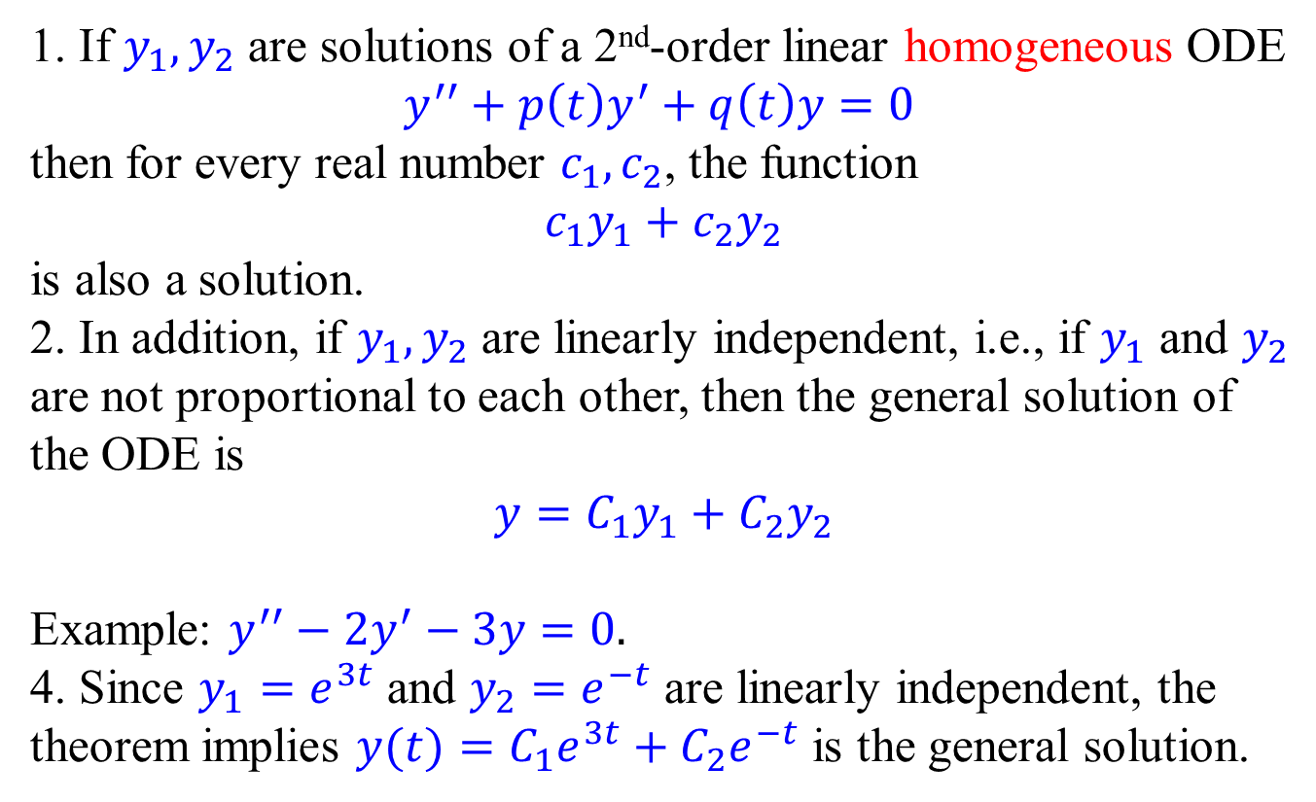
Principle of Superposition
1. If $y_{1},y_{2}$ are solutions of a 2nd-order linear homogeneous ODE
$$y^{′′}+p\left(t\right)y^{′}+q\left(t\right)y=0$$ then for every real number $c_{1},c_{2}$, the function
$$c_{1}y_{1}+c_{2}y_{2}$$
is also a solution.
2. In addition, if $y_{1},y_{2}$ are linearly independent, i.e., if $y_{1}$ and $y_{2}$ are not proportional to each other, then the general solution of the ODE is
$$y=C_{1}y_{1}+C_{2}y_{2}$$
Example: $y^{′′}−2y^{′}−3y=0.$
4. Since $y_{1}=e^{3t}$ and $y_{2}=e^{−t}$ are linearly independent, the theorem implies $y(t)=C_{1}e^{3t}+C_{2}e^{−t}$ is the general solution.

Slide 9
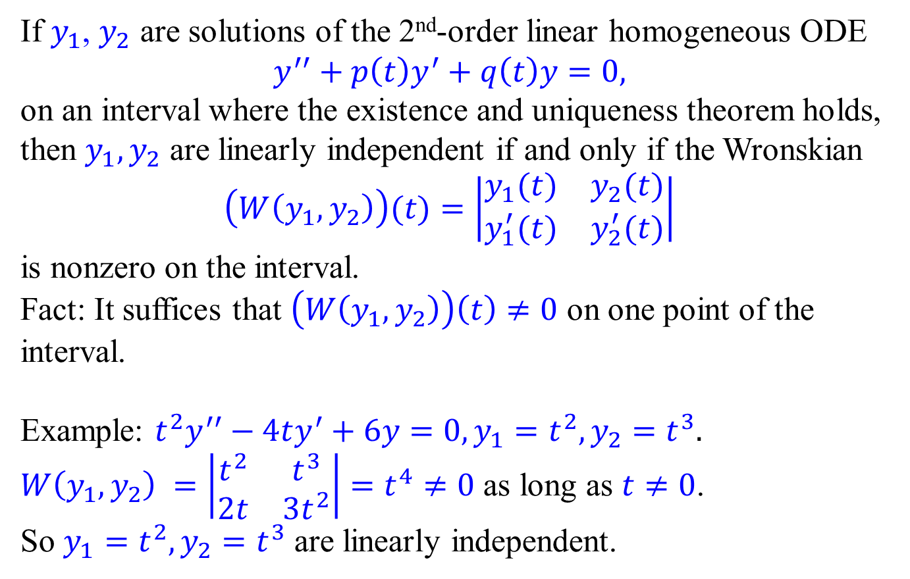
Wronskian for linear independence
If $y_{1}$, $y_{2}$ are solutions of the 2nd-order linear homogeneous ODE
$$y^{′′}+p\left(t\right)y^{′}+q\left(t\right)y=0,$$
on an interval where the existence and uniqueness theorem holds, then $y_{1},y_{2}$ are linearly independent if and only if the Wronskian
$$\left(W\left(y_{1},y_{2}\right)\right)(t)=\left|\begin{matrix}y_{1}(t) & y_{2}(t) \\ y_{1}^{′}(t) & y_{2}^{′}(t)\end{matrix}\right|$$
is nonzero on the interval.
Fact: It suffices that $\left(W\left(y_{1},y_{2}\right)\right)\left(t\right)≠0$ on one point of the interval.
Example: $t^{2}y^{′′}−4ty^{′}+6y=0, y_{1}=t^{2},y_{2}=t^{3}.$
$W\left(y_{1},y_{2}\right) =\left|\begin{matrix}t^{2} & t^{3} \\ 2t & 3t^{2}\end{matrix}\right|=t^{4}≠0$ as long as $t≠0$.
So $y_{1}=t^{2},y_{2}=t^{3}$ are linearly independent.

Slide 10
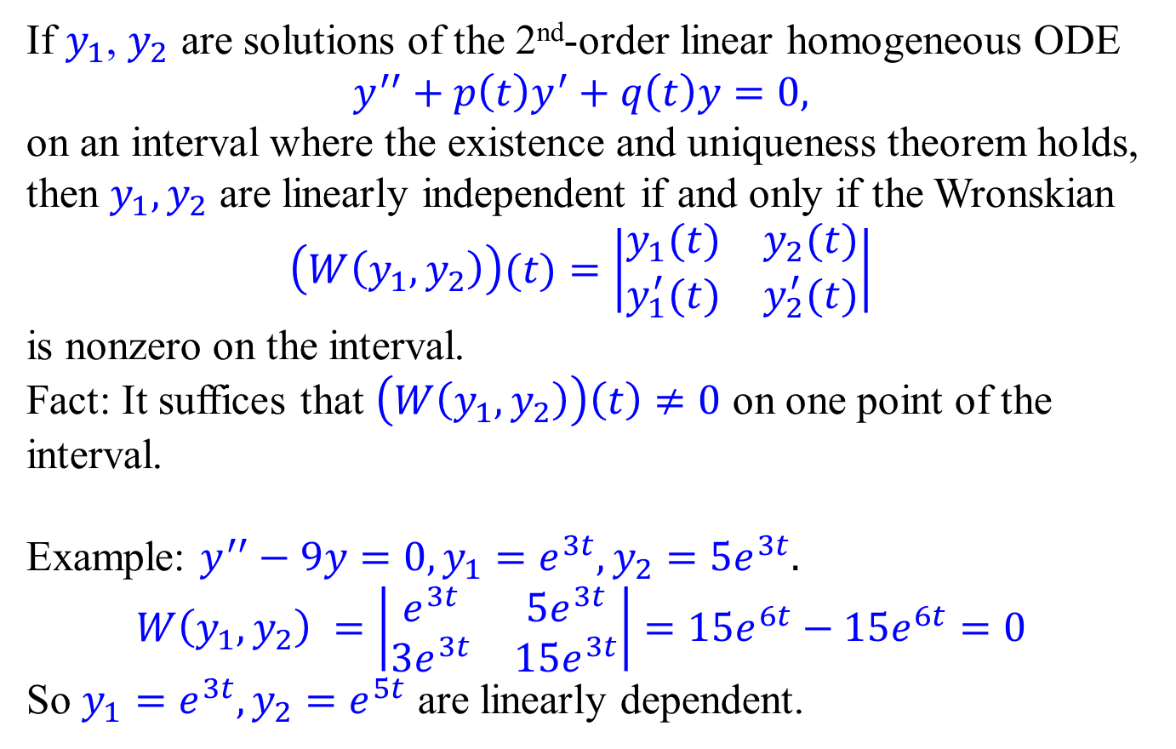
Wronskian for linear independence
If $y_{1}$, $y_{2}$ are solutions of the 2nd-order linear homogeneous ODE
$$y^{′′}+p\left(t\right)y^{′}+q\left(t\right)y=0,$$
on an interval where the existence and uniqueness theorem holds, then $y_{1},y_{2}$ are linearly independent if and only if the Wronskian
$$\left(W\left(y_{1},y_{2}\right)\right)(t)=\left|\begin{matrix}y_{1}(t) & y_{2}(t) \\ y_{1}^{′}(t) & y_{2}^{′}(t)\end{matrix}\right|$$
is nonzero on the interval.
Fact: It suffices that $\left(W\left(y_{1},y_{2}\right)\right)\left(t\right)≠0$ on one point of the interval.
Example: $y^{′′}−9y=0, y_{1}=e^{3t},y_{2}=5e^{3t}.$
$$W\left(y_{1},y_{2}\right) =\left|\begin{matrix}e^{3t} & 5e^{3t} \\ 3e^{3t} & 15e^{3t}\end{matrix}\right|=15e^{6t}−15e^{6t}=0$$
So $y_{1}=e^{3t},y_{2}=e^{5t}$ are linearly dependent.

Slide 11
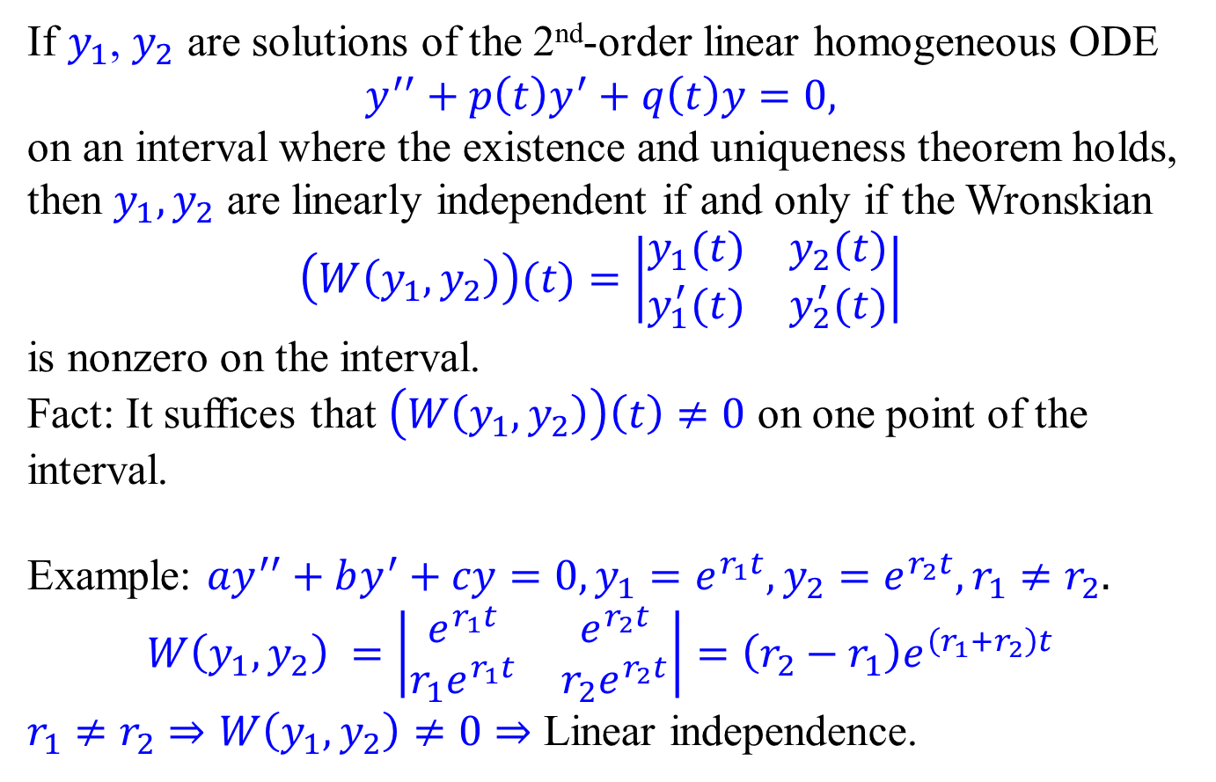
Wronskian for linear independence
If $y_{1}$, $y_{2}$ are solutions of the 2nd-order linear homogeneous ODE
$$y^{′′}+p\left(t\right)y^{′}+q\left(t\right)y=0,$$
on an interval where the existence and uniqueness theorem holds, then $y_{1},y_{2}$ are linearly independent if and only if the Wronskian
$$\left(W\left(y_{1},y_{2}\right)\right)(t)=\left|\begin{matrix}y_{1}(t) & y_{2}(t) \\ y_{1}^{′}(t) & y_{2}^{′}(t)\end{matrix}\right|$$
is nonzero on the interval.
Fact: It suffices that $\left(W\left(y_{1},y_{2}\right)\right)\left(t\right)≠0$ on one point of the interval.
Example: ${ay}^{′′}+by^{′}+cy=0, y_{1}=e^{r_{1}t},y_{2}=e^{r_{2}t},r_{1}≠r_{2}.$
$$W\left(y_{1},y_{2}\right) =\left|\begin{matrix}e^{r_{1}t} & e^{r_{2}t} \\ r_{1}e^{r_{1}t} & r_{2}e^{r_{2}t}\end{matrix}\right|=\left(r_{2}−r_{1}\right)e^{\left(r_{1}+r_{2}\right)t}$$
$r_{1}≠r_{2}⇒W\left(y_{1},y_{2}\right)≠0⇒$ Linear independence.

Slide 12
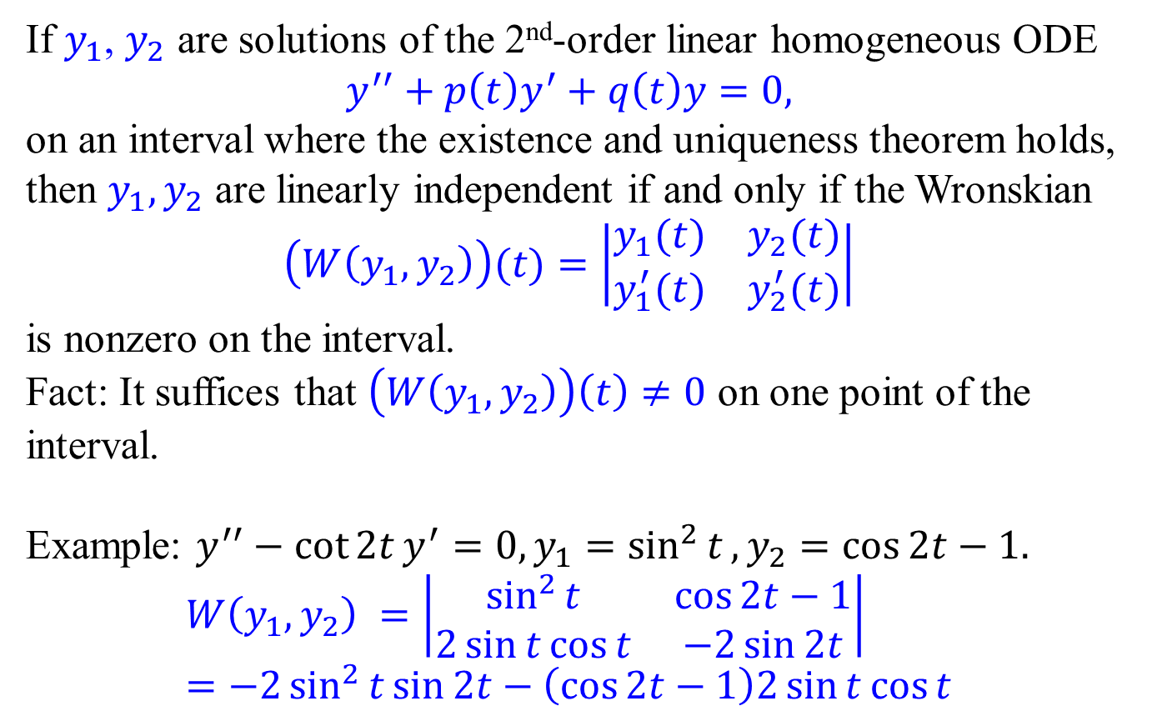
Wronskian for linear independence
If $y_{1}$, $y_{2}$ are solutions of the 2nd-order linear homogeneous ODE
$$y^{′′}+p\left(t\right)y^{′}+q\left(t\right)y=0,$$
on an interval where the existence and uniqueness theorem holds, then $y_{1},y_{2}$ are linearly independent if and only if the Wronskian
$$\left(W\left(y_{1},y_{2}\right)\right)(t)=\left|\begin{matrix}y_{1}(t) & y_{2}(t) \\ y_{1}^{′}(t) & y_{2}^{′}(t)\end{matrix}\right|$$
is nonzero on the interval.
Fact: It suffices that $\left(W\left(y_{1},y_{2}\right)\right)\left(t\right)≠0$ on one point of the interval.
Example: $y^{′′}−\cot{2t}y^{′}=0, y_{1}=\sin^{2}{t}, y_{2}=\cos{2t}−1.$
$$W\left(y_{1},y_{2}\right) =\left|\begin{matrix}\sin^{2}{t} & \cos{2t}−1 \\ 2\sin{t\cos{t}} & −2\sin{2t}\end{matrix}\right| \\ =−2\sin^{2}{t}\sin{2t}−\left(\cos{2t}−1\right)2\sin{t}\cos{t}$$

Slide 13
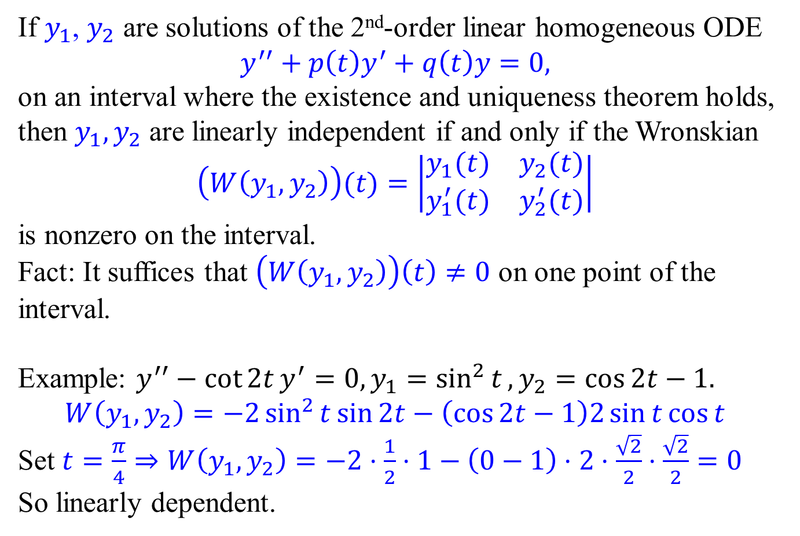
Wronskian for linear independence
If $y_{1}$, $y_{2}$ are solutions of the 2nd-order linear homogeneous ODE
$$y^{′′}+p\left(t\right)y^{′}+q\left(t\right)y=0,$$
on an interval where the existence and uniqueness theorem holds, then $y_{1},y_{2}$ are linearly independent if and only if the Wronskian
$$\left(W\left(y_{1},y_{2}\right)\right)(t)=\left|\begin{matrix}y_{1}(t) & y_{2}(t) \\ y_{1}^{′}(t) & y_{2}^{′}(t)\end{matrix}\right|$$
is nonzero on the interval.
Fact: It suffices that $\left(W\left(y_{1},y_{2}\right)\right)\left(t\right)≠0$ on one point of the interval.
Example: $y^{′′}−\cot{2t}y^{′}=0, y_{1}=\sin^{2}{t}, y_{2}=\cos{2t}−1.$
$$W\left(y_{1},y_{2}\right)=−2\sin^{2}{t}\sin{2t}−\left(\cos{2t}−1\right)2\sin{t}\cos{t}$$
Set $t=\frac{π}{4}⇒W\left(y_{1},y_{2}\right)=−2⋅\frac{1}{2}⋅1−\left(0−1\right)⋅2⋅\frac{\sqrt{2}}{2}⋅\frac{\sqrt{2}}{2}=0$
So linearly dependent.

Slide 14
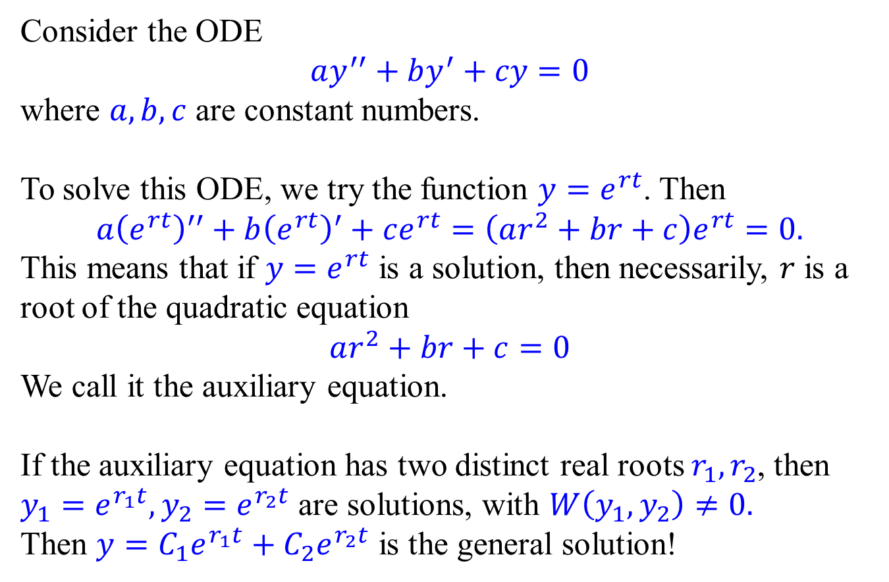
Linear Homogeneous ODE with Constant Coeffs.
Consider the ODE
$$ay^{′′}+by^{′}+cy=0$$
where $a,b,c$ are constant numbers.
To solve this ODE, we try the function $y=e^{rt}$. Then
$$a{\left(e^{rt}\right)}^{′′}+b{\left(e^{rt}\right)}^{′}+ce^{rt}=\left(ar^{2}+br+c\right)e^{rt}=0.$$
This means that if $y=e^{rt}$ is a solution, then necessarily, $r$ is a root of the quadratic equation
$$ar^{2}+br+c=0$$
We call it the auxiliary equation.
If the auxiliary equation has two distinct real roots $r_{1},r_{2}$, then $y_{1}=e^{r_{1}t}, y_{2}=e^{r_{2}t}$ are solutions, with $W\left(y_{1},y_{2}\right)≠0.$
Then $y=C_{1}e^{r_{1}t}+C_{2}e^{r_{2}t}$ is the general solution!

Slide 15
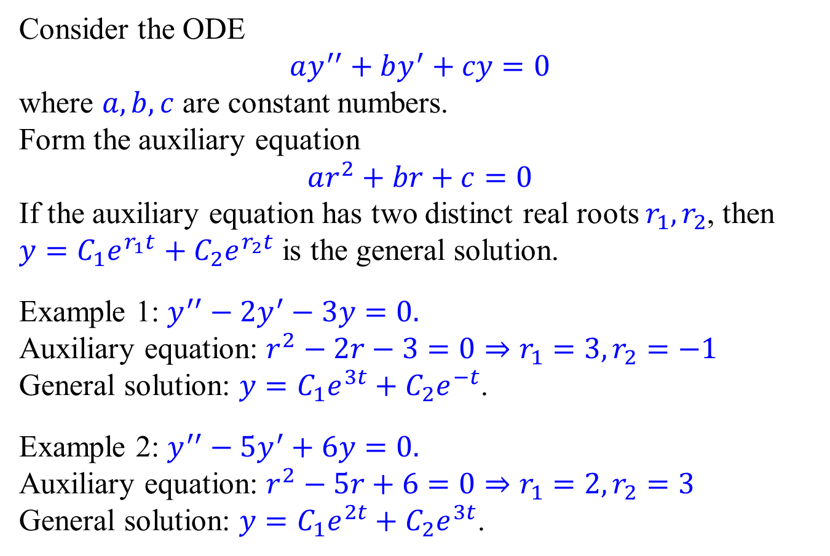
Linear Homogeneous ODE with Constant Coeffs.
Consider the ODE
$$ay^{′′}+by^{′}+cy=0$$
where $a,b,c$ are constant numbers.
Form the auxiliary equation
$$ar^{2}+br+c=0$$
If the auxiliary equation has two distinct real roots $r_{1},r_{2}$, then $y=C_{1}e^{r_{1}t}+C_{2}e^{r_{2}t}$ is the general solution.
Example 1: $y^{′′}−2y^{′}−3y=0.$
Auxiliary equation: $r^{2}−2r−3=0⇒r_{1}=3,r_{2}=−1$
General solution: $y=C_{1}e^{3t}+C_{2}e^{−t}$.
Example 2: $y^{′′}−5y^{′}+6y=0.$
Auxiliary equation: $r^{2}−5r+6=0⇒r_{1}=2,r_{2}=3$
General solution: $y=C_{1}e^{2t}+C_{2}e^{3t}$.

Slide 16
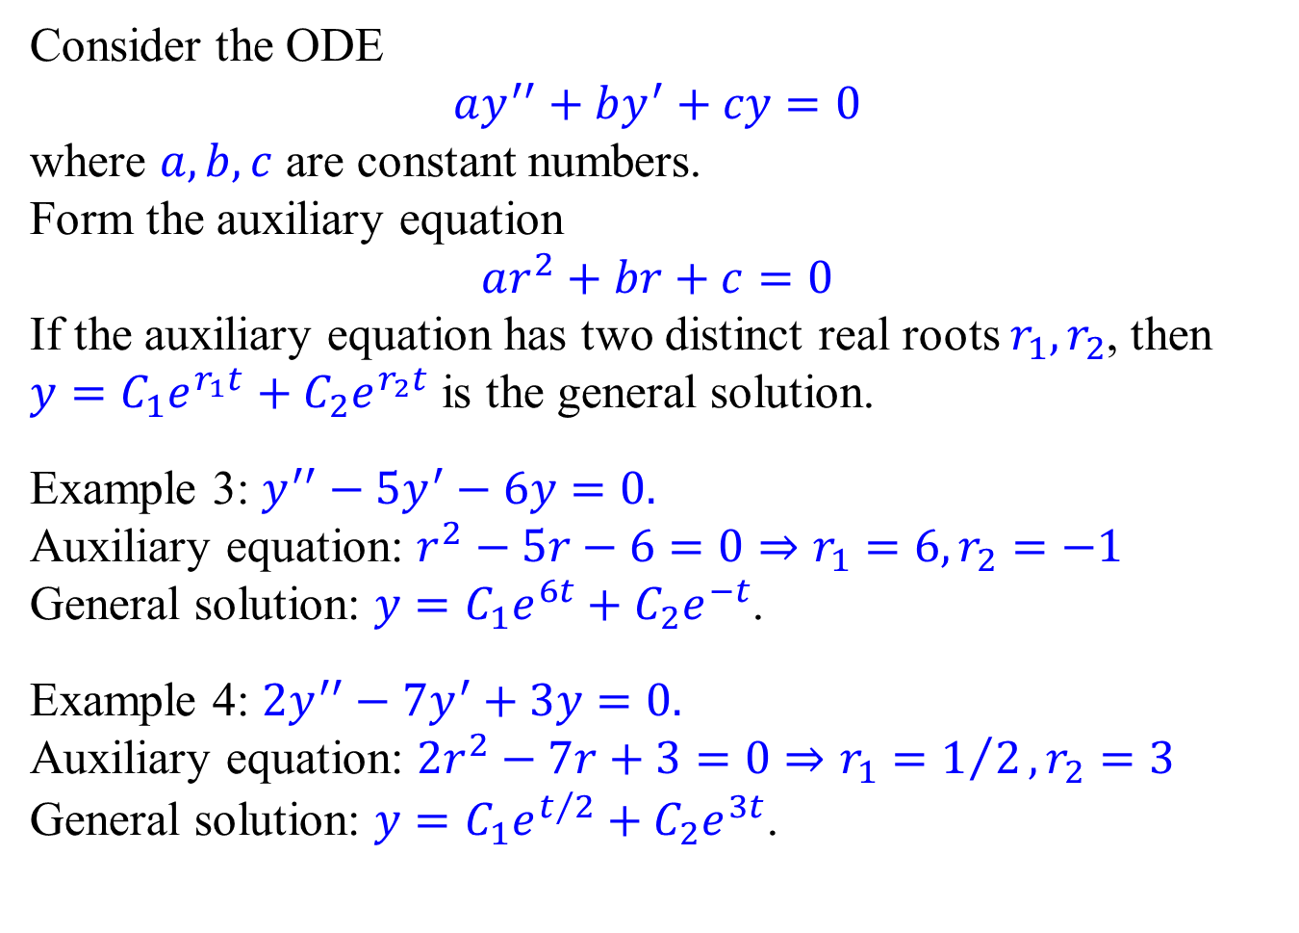
Linear Homogeneous ODE with Constant Coeffs.
Consider the ODE
$$ay^{′′}+by^{′}+cy=0$$
where $a,b,c$ are constant numbers.
Form the auxiliary equation
$$ar^{2}+br+c=0$$
If the auxiliary equation has two distinct real roots $r_{1},r_{2}$, then $y=C_{1}e^{r_{1}t}+C_{2}e^{r_{2}t}$ is the general solution.
Example 3: $y^{′′}−5y^{′}−6y=0.$
Auxiliary equation: $r^{2}−5r−6=0⇒r_{1}=6,r_{2}=−1$
General solution: $y=C_{1}e^{6t}+C_{2}e^{−t}$.
Example 4: ${2y}^{′′}−7y^{′}+3y=0.$
Auxiliary equation: ${2r}^{2}−7r+3=0⇒r_{1}=1/2,r_{2}=3$
General solution: $y=C_{1}e^{t/2}+C_{2}e^{3t}$.

Slide 17
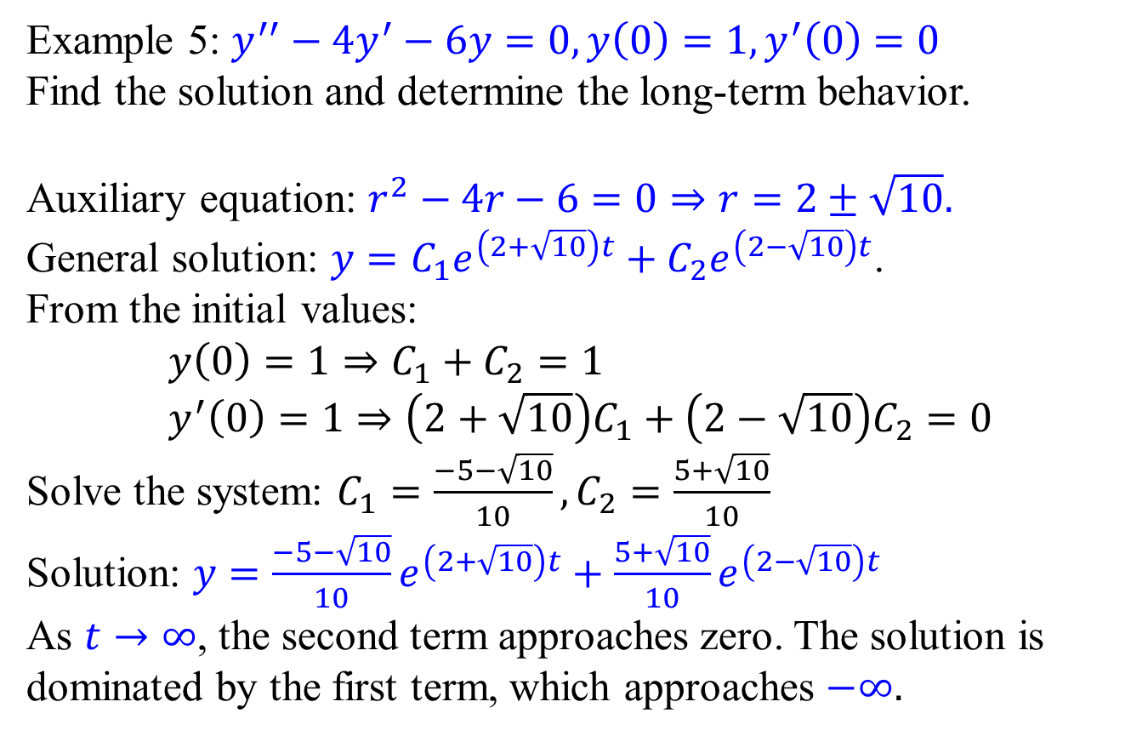
Initial Value Problems & Long-term behaviors
Example 5: $y^{′′}−4y^{′}−6y=0, y\left(0\right)=1,y^{′}\left(0\right)=0$
Find the solution and determine the long-term behavior.
Auxiliary equation: $r^{2}−4r−6=0⇒r=2±\sqrt{10}.$
General solution: $y=C_{1}e^{\left(2+\sqrt{10}\right)t}+C_{2}e^{\left(2−\sqrt{10}\right)t}$.
From the initial values:
$$y\left(0\right)=1⇒C_{1}+C_{2}=1 \\ y^{′}\left(0\right)=1⇒\left(2+\sqrt{10}\right)C_{1}+\left(2−\sqrt{10}\right)C_{2}=0$$
Solve the system: $C_{1}=\frac{−5−\sqrt{10}}{10},C_{2}=\frac{5+\sqrt{10}}{10}$
Solution: $y=\frac{−5−\sqrt{10}}{10}e^{\left(2+\sqrt{10}\right)t}+\frac{5+\sqrt{10}}{10}e^{\left(2−\sqrt{10}\right)t}$
As $t→∞$, the second term approaches zero. The solution is dominated by the first term, which approaches $−∞.$

